Slide 1
TECH TRANSFER & COMMERCIALIZATION
UNIVERSITY OF NEBRASKA

Slide 2
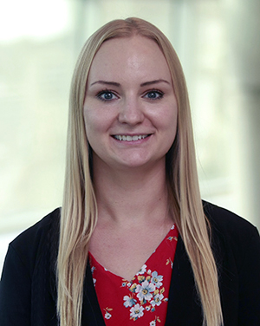
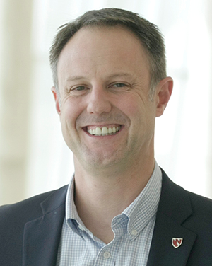
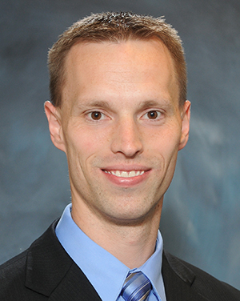
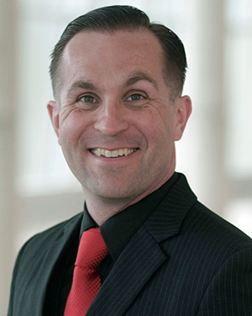
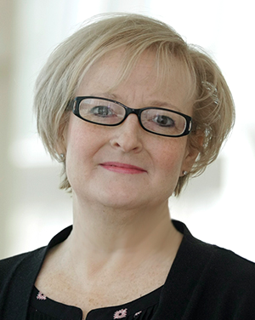
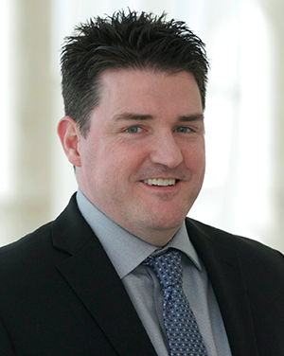
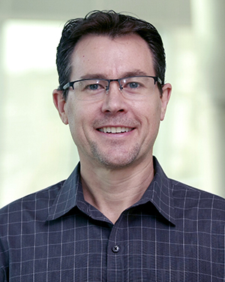
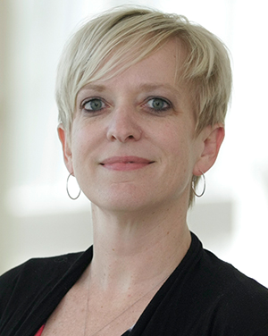
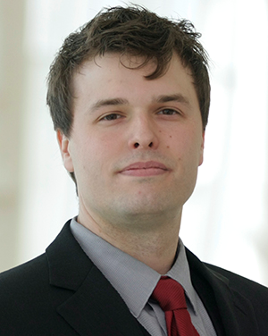
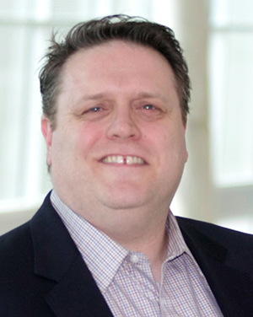
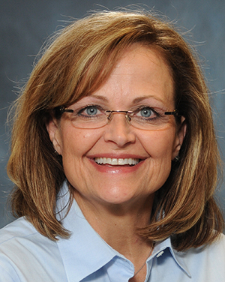
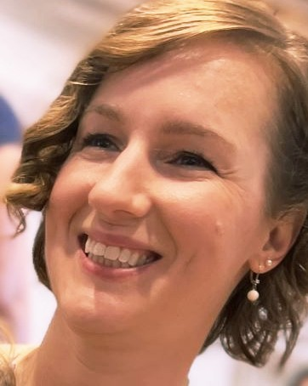
We are UNeMed
Tyler Scherr, Ph.D.
Licensing Specialist
(402) 559-2140
tyler.scherr@unmc.edu

Slide 3
OUR MISSION
Fostering and commercializing Innovation at the University of Nebraska
Transfer Technology
Derive economic benefit
Increase corporate
Develop
local
and knowledge to commercial sector where it can have the greatest potential to positively affect healthcare
that can be used to further advance research at the university of Nebraska
and industrial relationships at the University of Nebraska
economy and remain a primary resource and service to faculty, students and staff
Notes:
Background placeholder: After choosing your image, Right click on the image -> Send to back -> Click on send to back

Slide 4
OUR SERVICES
Invention Evaluation
IP Protection
Commercial Partnerships
Patentability and Market Assessment
Patents, copyrights, trademarks, trade secrets…
Market technologies for licensing and research collaborations
Agreement Negotiation
Start-up Companies
Education/Outreach
Help with formation and connect to additional resources
Seminars, workshops, alternative career opportunities
Licenses, SRAs, MTAs, CDAs…

Slide 5
WHEN TO CALL UNEMED?
We welcome any questions related to intellectual property, technology development, marketing or licensing; but more pressing concerns typically involve…
New Discovery
Startups
that may be useful to industry: inventions, software, devices, unique materials
if you are interested in starting your own company
Industry
Agreements
has expressed an interest in your research
you may be given to receive materials or information

Slide 6
COMMERCIALIZATION PROCESS
No two inventions are the same, but the path from disclosure to commercialization could look something like this…
Invention Disclosure
Commercialization
Process begins with a completed NIN form and meeting with the inventor; some marketing may begin with a CDA
Protection
License to new company; exclusive; non-exclusive; option; sponsored research; build startup company
Patent applications; copyright or trademark; market as material
Evaluation
Marketing
Examined for patentability & marketability; findings presented to committee; more data may be required before moving forward; committee recommendation discussed with inventor
UNeMed.com; External websites; inventor contacts; UNeMed contacts; MedTrack DB; Frost and Sullivan; etc.

Slide 7
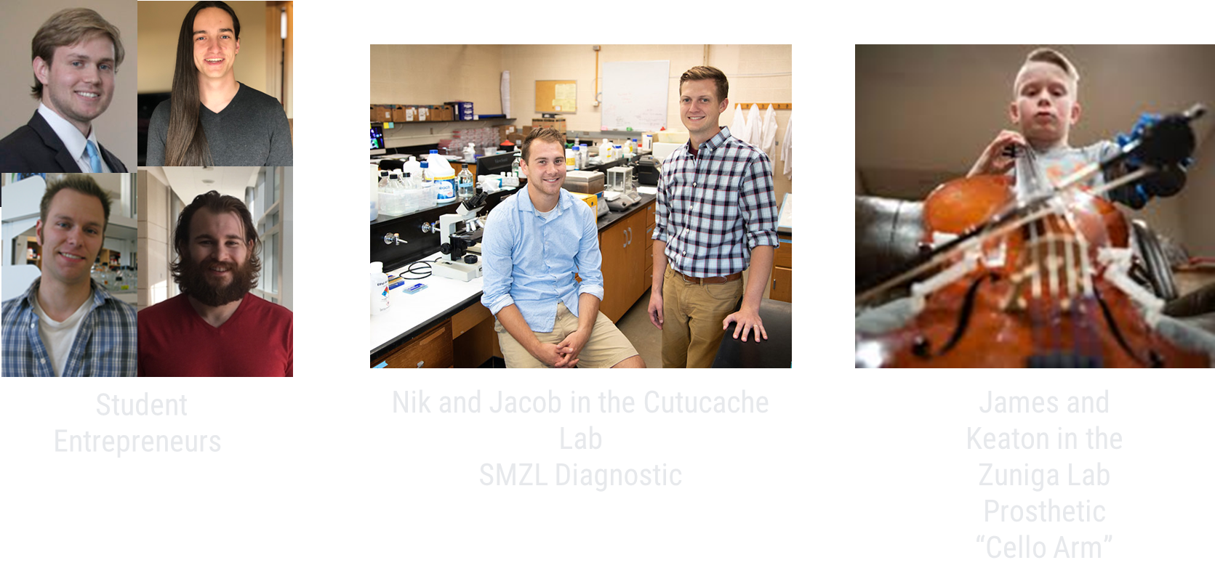
GRAD STUDENT RECENT HIGHLIGHTS

Slide 8
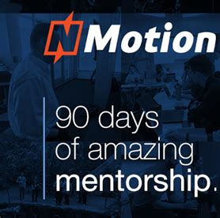
ENTREPRENEURIAL RESOURCES
WE WANT YOU TO BE SUCCESSFUL!
STARTUP
SUPPORT
PROTOTYPING
PITCHING
3D Printing
Electronics
Metal/Wood
NBDC
UNeTech Institute
Greater Omaha Chamber
Nmotion
Destination Startup
Pipeline
UNeTech
FUNDING
GRANTS
IP
Maverick Ventures
Nebraska Angels
Invest Nebraska
SPA
ORCA
NBDC
NE DeD
Patents
Copyrights
Trademarks
Brands

Slide 9
CONTACT US!
If you believe you may have a new invention with some supporting data
If you are working with an external partner
Before publicly disclosing your invention
Seminars, papers, posters, abstracts, grants, IRB studies, etc.
Foreign patent rights are lost upon public disclosure
1 year to file for US patent rights
We will work with an inventor’s needs to publish/present
We can file provisional patents
rather quickly if needed

Slide 10
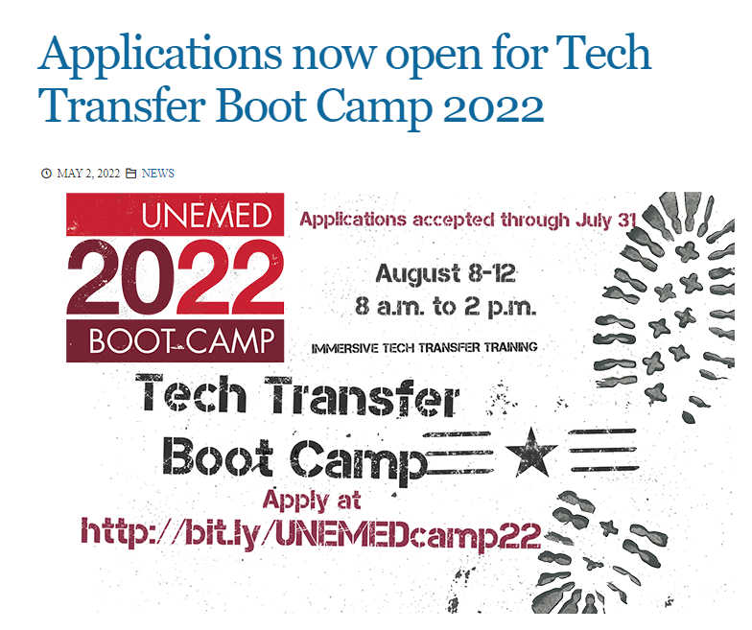
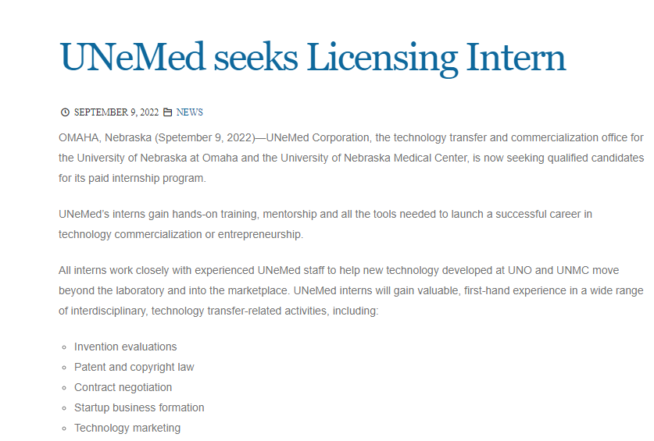
UNEMED OPPORTUNITIES

Slide 11
T E C H T R A N S F E R
FOR THE UNIVERSITY OF NEBRASKA

