Slide 1
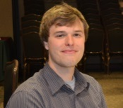
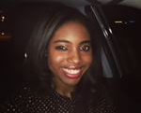
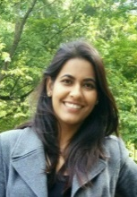
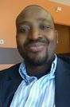
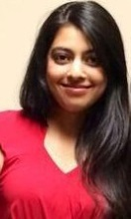
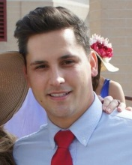
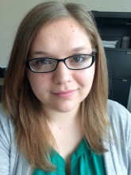
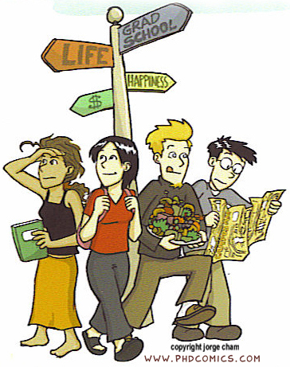
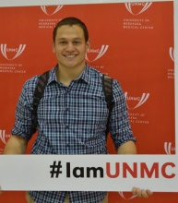
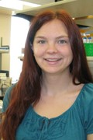
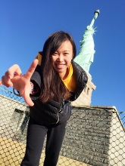
GSA Executive Council
UNMC Graduate Student Association
President: Tyler Scherr,
tyler.scherr@unmc.edu
Vice-President: Shalis Ammons, shalis.ammons@unmc.edu
The Graduate Student Association (GSA) is the representative for all graduate students at UNMC!
International Student Chairs: Simarjeet Negi, simarjeet.negi@unmc.edu & Zoumana Traore, zoumana.traore@unmc.edu
Secretary: Rajvi Wani, rajvi.wani@unmc.edu
Many ways to stay connected to GSA & receive important student information:
Weekly GSA Emails
GSA Blog: blog.unmc.edu/gsa/
GSA Facebook Group
UNMC GSA YouTube Channel
UNMC GSA on Twitter
Treasurer: Shashank Shrishrimal,
shashank.shrishrimal@unmc.edu
Alumni Chair: Tim Bielecki, tim.bielecki@unmc.edu
Outreach Chair: Kristin Wipfler, kristin.wipfler@unmc.edu
2015-2016
Academic Year
Interprofessional Education Chair:
Keenan Hartert, Keenan.hartert@unmc.edu
Social Chairs: Margaret Taylor, margaret.taylor@unmc.edu and
Cheng Wang, cheng.wang@unmc.edu
Notes:
Front and Back

Slide 2
Join a GSA Committee and make your voice heard!
Upcoming GSA Events:
Friday, August 21st – Welcome Back BBQ
5 - 10 pm on Sorrell green space
OR Sorrell 2nd Floor Commons if raining
Thursday, September 3rd – GSA Monthly Meeting
12:00 – 1:00 PM in DRC1 1005
Monthly meetings will be held on the first
Thursday of each month!
International Student Affairs – Addressing concerns and providing social opportunities for international graduate students.
Chairs: Simarjeet Negi and Zoumana Traore
Social Events – Promoting social interactions of our graduate students by scheduling and hosting GSA-sponsored social events.
Chairs: Margaret Taylor and Cheng Wang
Student Issues – Responsible for addressing any issues or concerns pertaining to graduate students.
Chair: Shalis Ammons
Alumni/Outreach/Interprofessional– Improving networking, educational, career, and volunteer opportunities for graduate students.
Chairs: Tim Bielecki, Kristin Wipfler, Keenan Hartert
Benefits of GSA include:
Receiving educational and career guidance
Staying informed on upcoming events, opportunities, and deadlines
Getting leadership experience
Enjoying fun activities and food with friends
Ability to voice your opinion to effect change at UNMC
Join us at GSA’s
Welcome Back BBQ and Movie Night!
Date: Friday, August 21st
Location: Sorrell Center Green Space
Time: 5:00 PM– 10:00 PM
Students eat for free, friends & family pay $5
Notes:
Inside

